Slide 1
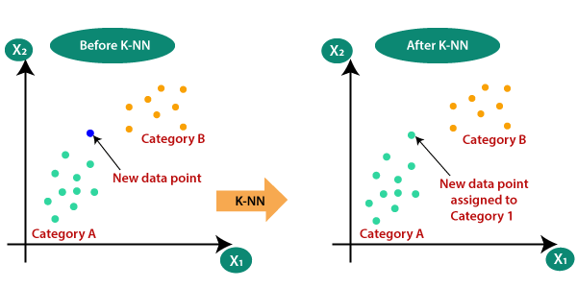
K-Nearest Neighbors (KNN):
Type: Supervised learning algorithm.
Used for: Classification and regression.
Basic Idea: To predict the class or value of a data point based on the 'k' most similar data points in the training set.
How KNN Works
Choose the number of neighbors (k):
Select the number of neighbors (k) to consider for making the prediction.
Calculate distances:
Compute the distance between the new data point and all the training data points. Common distance metrics include Euclidean, Manhattan, and Minkowski distances.
Identify the nearest neighbors:
Identify the 'k' training data points that are closest to the new data point based on the calculated distances.
Make a prediction:
Prediction
Classification
recommendation

Slide 2
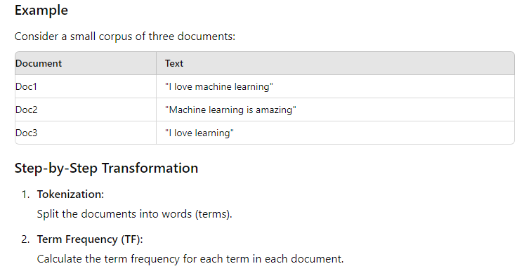
Understanding TfidfVectorizer with Examples
The TfidfVectorizer is a feature extraction tool in Natural Language Processing (NLP) that transforms text data into numerical data
using the Term Frequency-Inverse Document Frequency (TF-IDF) method.

Slide 3
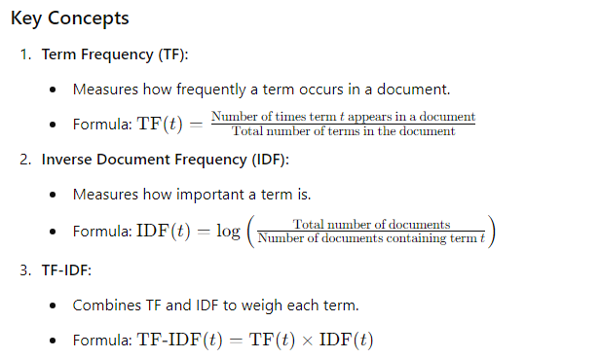

Slide 4
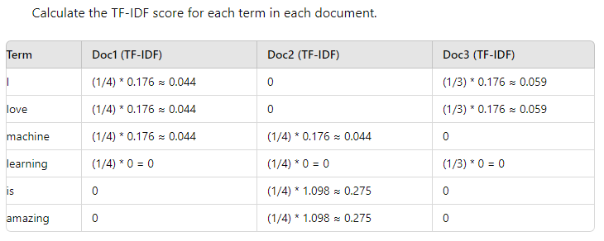

Slide 5
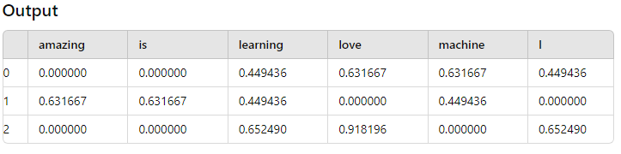
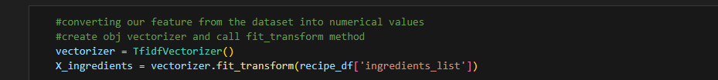
Implementation in my project:

Slide 6
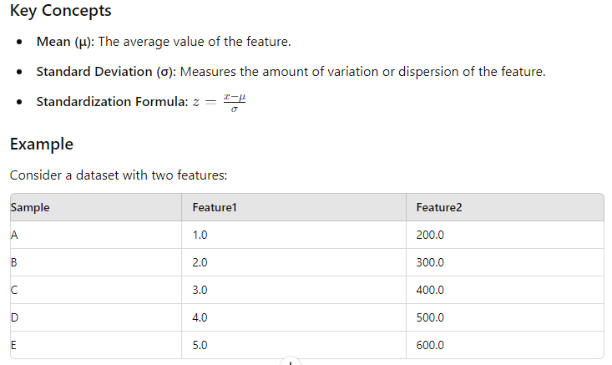
Standard Scaler

Slide 7
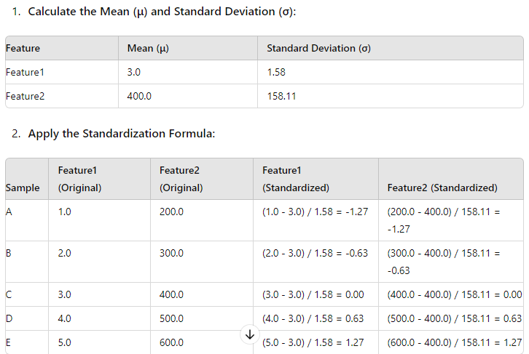

Slide 8
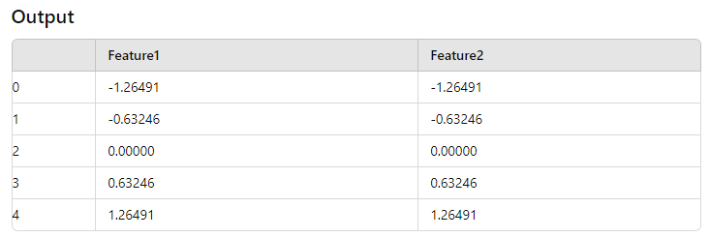
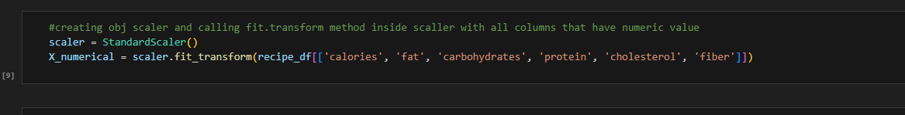
Implementation in my project:

